Slide 1
GeoLocation Data

Slide 2
Useful
All types of apps
Games
Identify nearby players
Maps
Travel
Distance to somewhere
Location based alarm
Exercise
Endless possibilities

Slide 3
Exercise
Exercise tracking
Recording routes
Keeping stats
Using the hardware to try and recognise an accident
Mountain biking – inactivity for period of time, then contact emergency contact

Slide 4
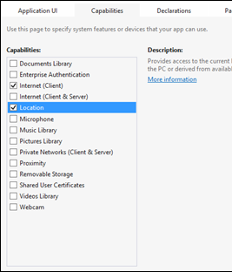
How to
Update the capabilities in the package manifest
Must declare that we need this
Doesn’t lead to errors
Just no data

Slide 5
User Permission
Accessing the data will prompt the user if the Location setting is off
User then has to turn it on to use the app
Hence, asking permission is done automatically
Also, as long as you don’t pass the data gathered to any other apps or services, then you don’t have to ask for more permission than this

Slide 6
Need
Geolocator
Found in Windows.Devices.Geolocation
First use must be on the UI thread to prompt use
Monitor PositionChanged event
Raised when the location is updated
Monitor StatusChanged
Raised when the ability of Geolocator to provide updates changes

Slide 7
Events
Add the events to the location object created in code
Remove on exit
Good practice
Then what?

Slide 8
PositionChanged
Gets the useful data
All from the GeoPosotion class
Accuracy
Measured in meters with latitude and longitude at the centre point of the circle
Timestamp
When the reading was taken
Includes timezone information

Slide 9
PositionChanged
Altitude
Elevation in metres
Mostly on devices with a barometer
Can be useful if available
Heading
Only displayed with a compass on board
Measures in degrees relative to true north
Speed
Not all devices will return this
May have to do maths by tracking coordinates over time

Slide 10
PositionChanged
Async/await
Location data happens on a background thread
Use the Dispatcher to connect back to the primary UI thread
Background threads do not have direct access to the UI thread

Slide 11
StatusChanged
notInitialized
Returned if application has not yet requested permission
Disabled
User declines request for permission
notAvailable
No support for location data
noData
Support, but can’t acquire (no wifi, inside etc)
Initializing
Between request for permission and receiving data
Ready
Data is available for use

Slide 12
Now what?
Event handlers set up
And get the data
Decide what you want to do with your app.
Writing a turn by turn tracker is a little more complex, so lets start with just getting my location and examining the data

